Slide 1

What you will learn Today
Introduction
High level Introduction of Software Testing and required skills
Start performing functional testing on Sample application

Slide 2
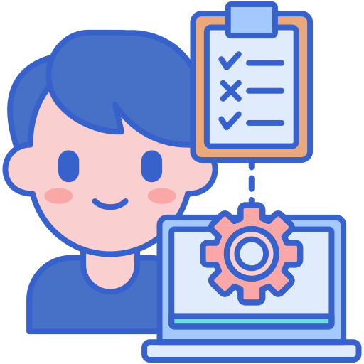
Table of Content
Introduction
Introduction To Software Testing
Who are Software Testers
Overview of Applications and Systems
Getting Started with Functional Testing
Lab Exercise

Slide 3
Introduction to Software Testing

Slide 4
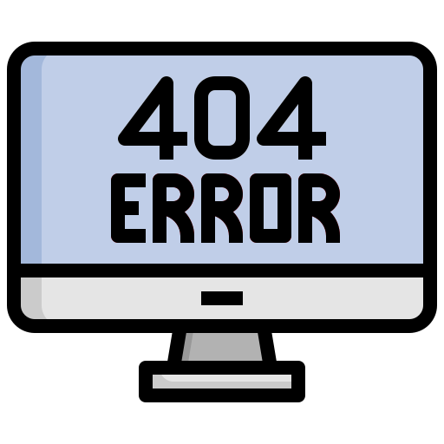
Seen any software failures in real life?
Why testing is important?
A smartphone mapping app showed a museum in middle of river – A basic functionality failure
Ariane 5 crashed 40 sec after takeoff because of incorrect calculation by its inertial reference system that was taken from Ariane 4 – An incompatible component reuse
UK’s top 10 most wanted criminals went down due to un-expected issue – A performance failure
A change in billing system of an electrical provider blacked out a city – An upgrade failure
A wide area blacked-out due to a hacking incident occurred in Ukraine – A security failure

Slide 5
So software can fail because of different types of issues functional, performance, security, integration, upgrade process, etc
Why testing is important?

Slide 6
Why do failures happen?
Why testing is important?
Humans are prone to making Mistakes
Failures
Event when a user experiences a problem
Fault
A failure is caused by a fault in software
Error
The cause of fault is an error or mistake by a person
Mistake/Error
Defect/Fault/Bug
Failure

Slide 7
Causes of failures
Why testing is important?
System Complexity
Deadlines Pressure
Organizational Limitations/Issues
Resource Capabilities
Limitations of knowledge available at that time
Algorithms limitations
Misunderstanding requirements
Typing Mistakes

Slide 8
How to avoid or rectify?
Why testing is important?
Testing can contribute towards timely avoidance and rectification, if its well integrated with software development lifecycle

Slide 9
Basic Definitions
What is Software Testing
Process of software testing offers an opportunity to discover any errors in the product under test
It’s a systematic exploration of a component/system with the main aim of finding and reporting defects

Slide 10
Typical Objectives
What is Software Testing
To prevent defects by evaluate work products such as requirements, user stories, design, and code
To verify whether all specified requirements have been fulfilled
To check whether the test object is complete and validate if it works as the users and other stakeholders expect
To build confidence in the level of quality of the test object
To find defects and failures by reducing the level of risk of inadequate software quality
To provide sufficient information to stakeholders to allow them to make informed decisions, especially regarding the level of quality of the test object
To comply with contractual, legal, or regulatory requirements or standards, and/or to verify the test object’s compliance with such requirements or standards

Slide 11
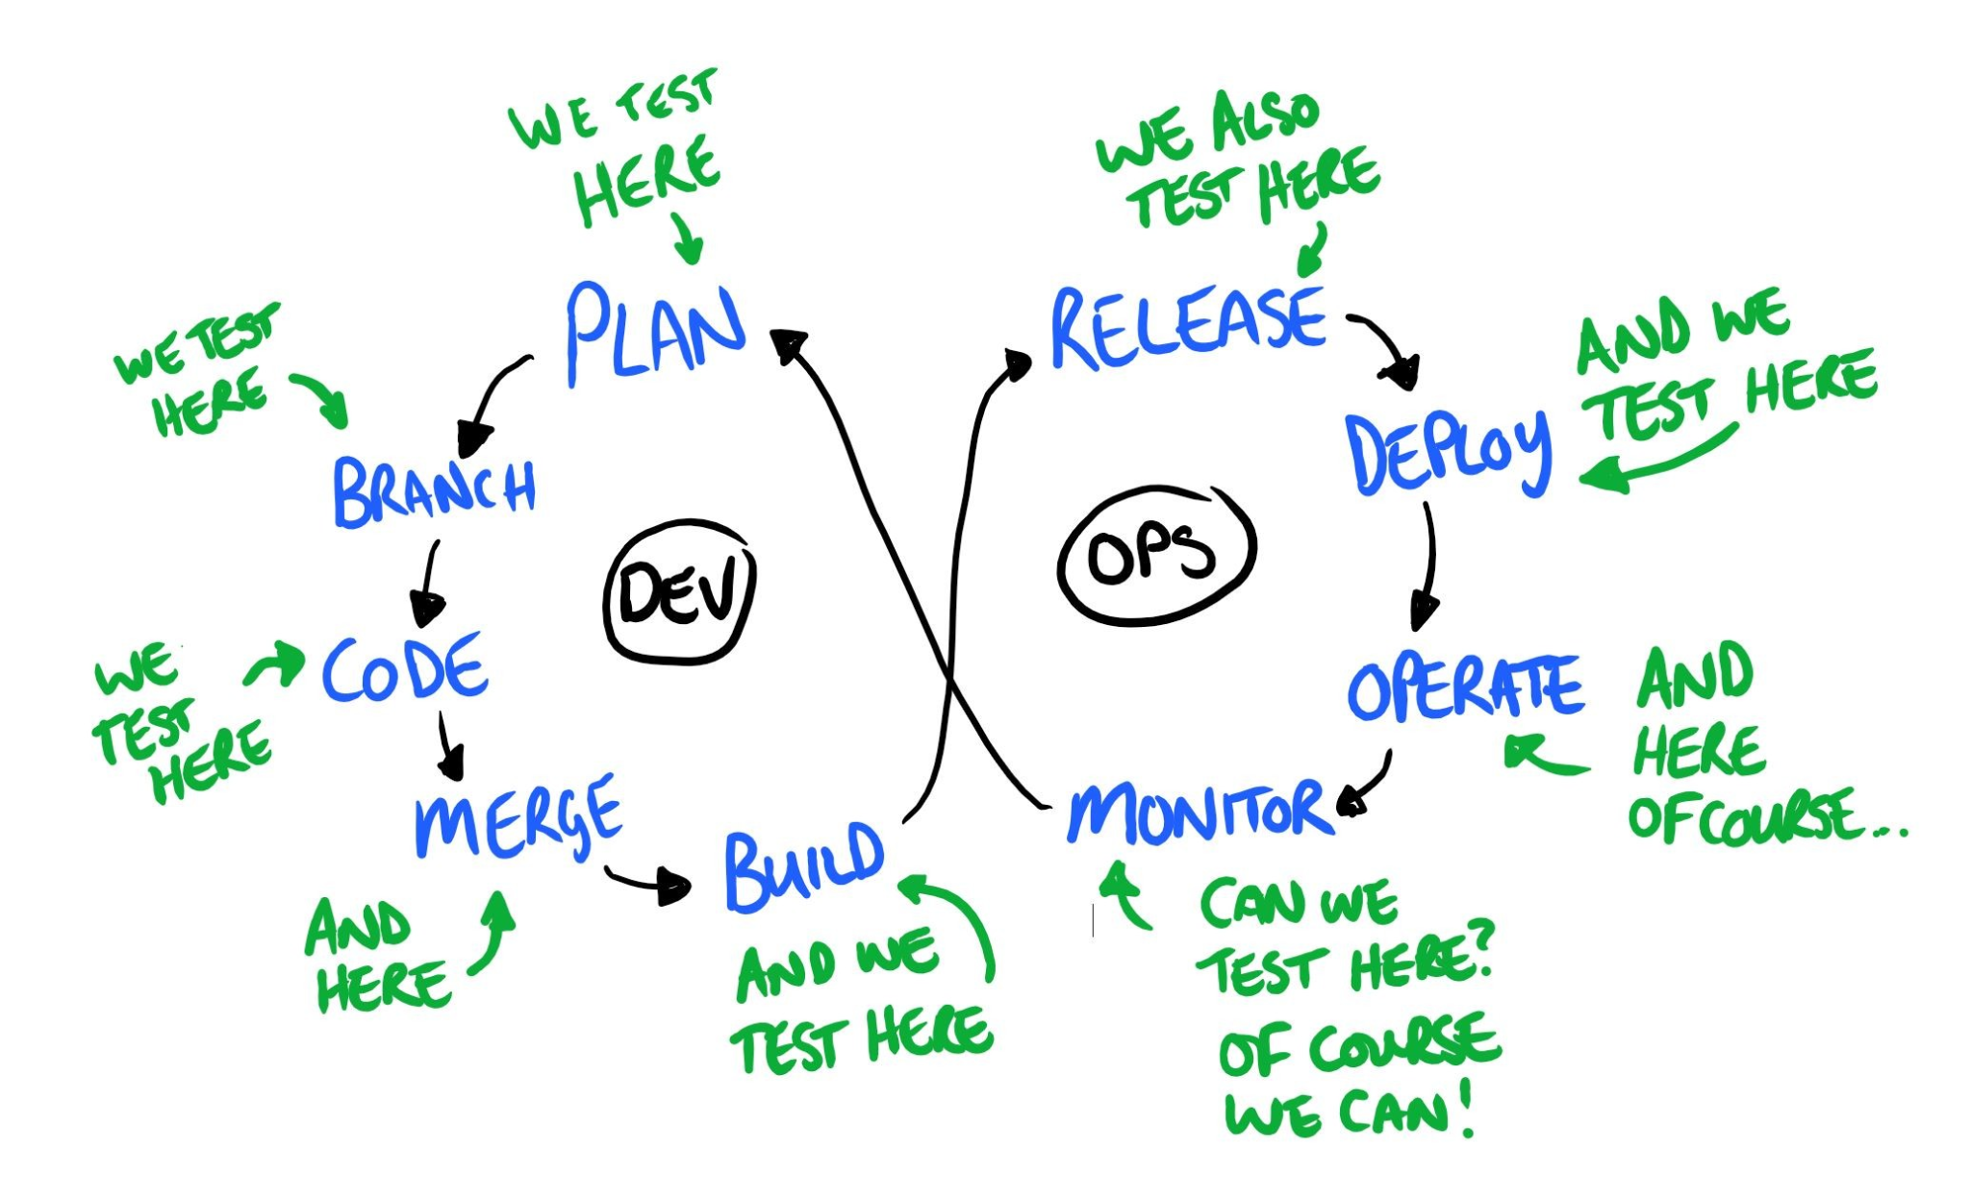
When do we test?
What is Software Testing

Slide 12
Basic Testing Process
What is Software Testing
Requirement Analysis
We will be discussing these in details. Starting with Test implementation and execution
Test Planning and Control
Test Analysis and Design
Test Implementation and Execution
Evaluating Exit Criteria and Reporting
Test Closure Activities

Slide 13
Testing, Quality Control and Quality Assurance
Common Terminologies
Testing
Attempts to find bugs
Quality Control
Attempts to built software systems and test it thoroughly
Quality Assurance
Enforce standards and techniques to improve process and prevent faults
Monitors and guides throughout the SDLC to improve software engineering practices

Slide 14
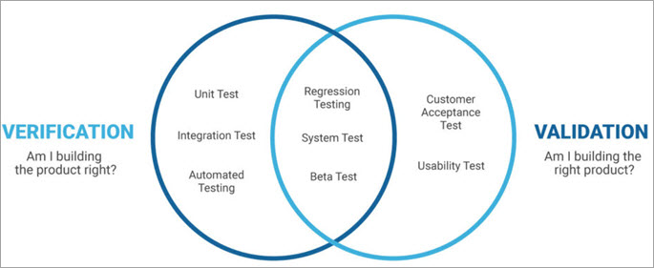
Verification and Validation
Common Terminologies
Verification
Confirmation by examination and through provision of objective evidence that specified requirements for each phase of SDLC have been fulfilled
Validation
Confirmation by examination and through provision of objective evidence that the requirements for a specific intended use or application have been fulfilled.

Slide 15
Static and Dynamic Testing
Common Terminologies
Static Testing
Testing of a software development artifact, e.g., requirements, design or code, without execution of these artifacts, e.g., reviews or static analysis
Dynamic Testing
Testing that involves the execution of the software of a component or system.

Slide 16
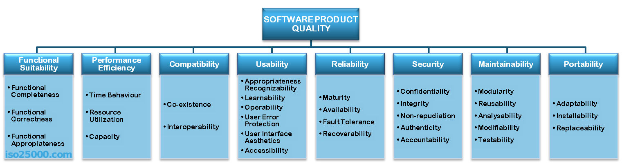
Quality as defined by ISO 25010
Common Terminologies
Provide consistent terminology for specifying, measuring and evaluating system and software product quality

Slide 17
Who are Software Tester

Slide 18
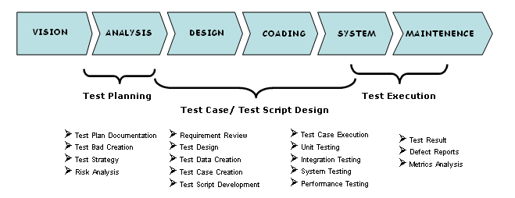
Technical Skills
Skill / Knowledge required to fulfill the QA role

Slide 19
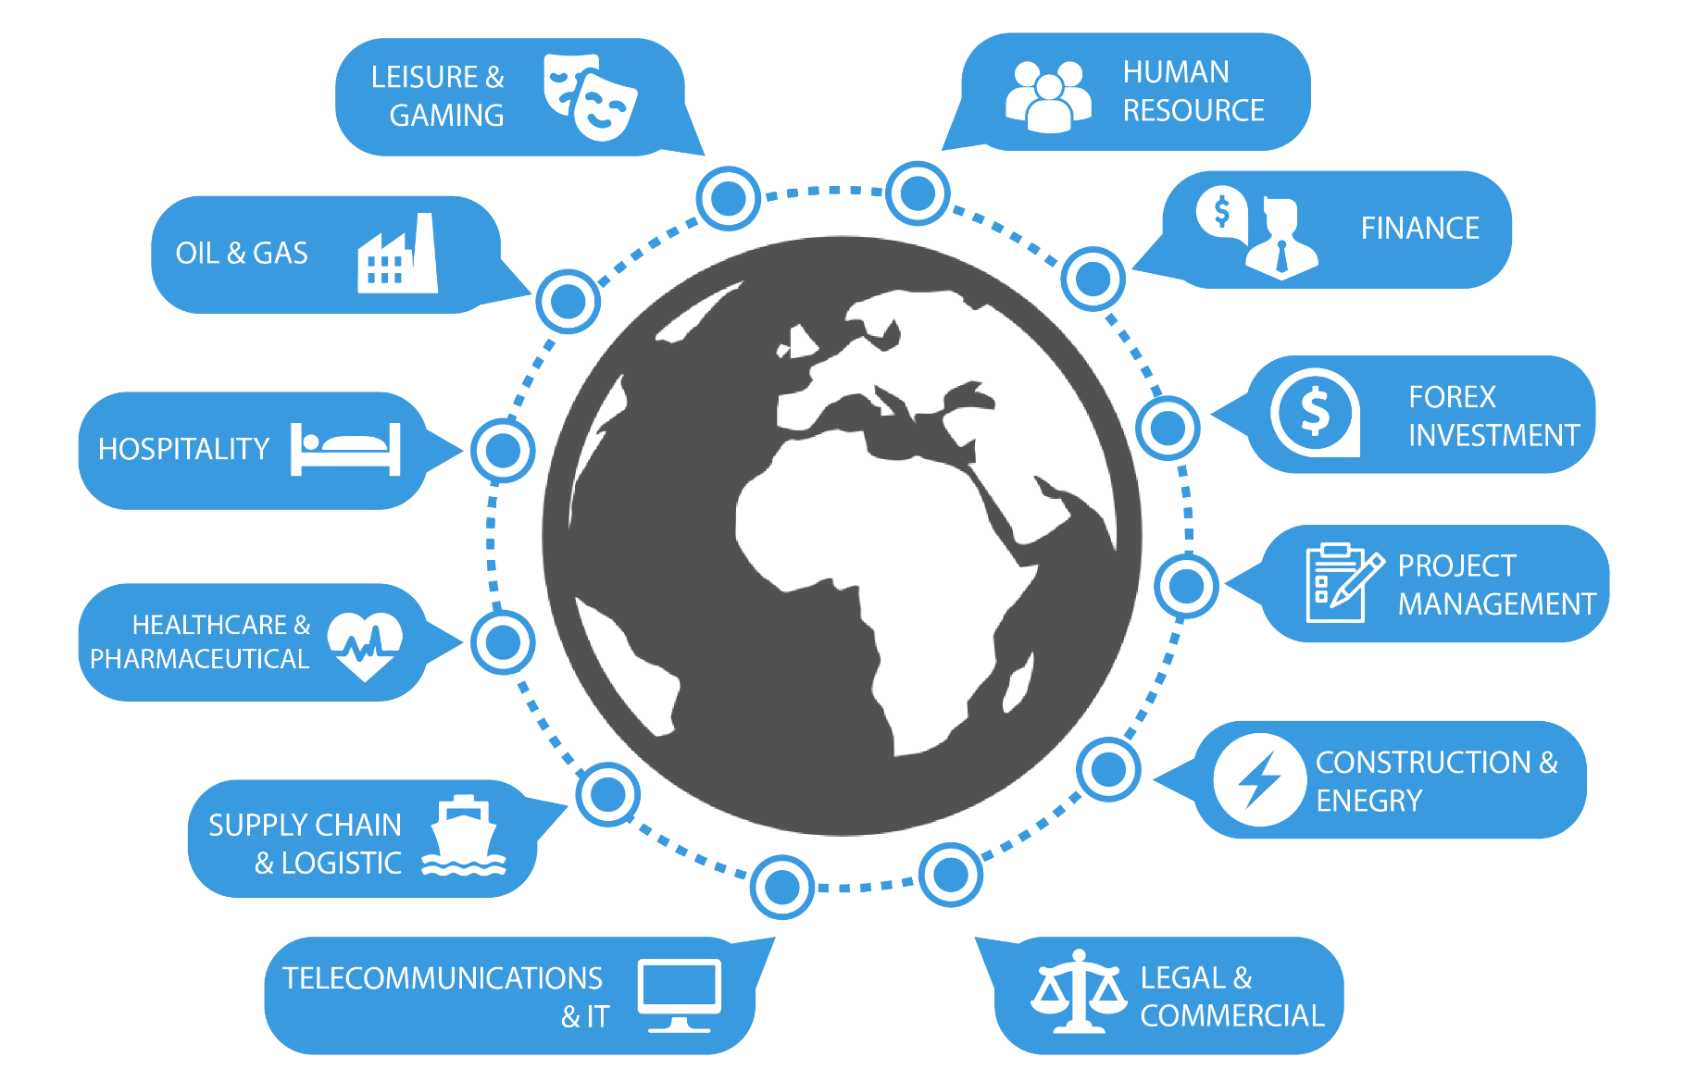
Technical Skills
Domain knowledge required for better testing

Slide 20
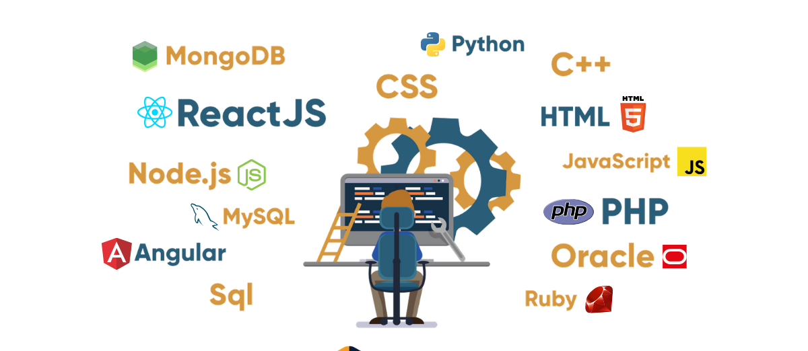
Technical Skills
Tech stack knowledge required for QA
To optimize testing strategies and tools

Slide 21
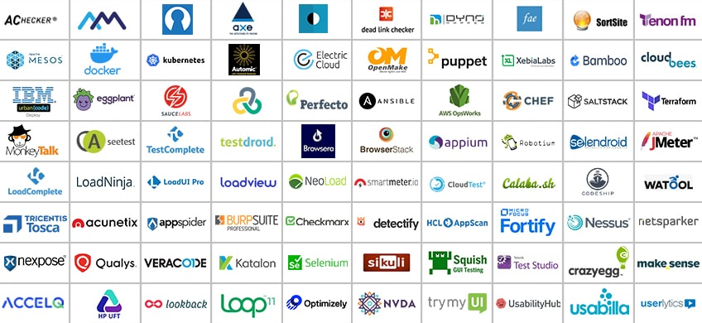
Technical Skills
Understanding of available tools for QAs

Slide 22
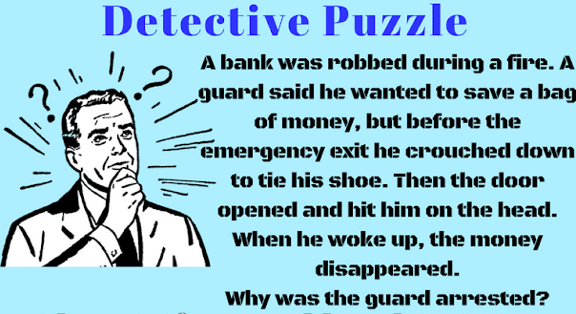
Soft Skills
Good Analytical skills
Detailed oriented and ability to put himself in shoes of multiple users
Notes:
Because emergency doors open from inside to outside. The guard was inside so the door could not have hit him.
Because the color coding is not recommended for color blind. It should have more contrast.

Slide 23
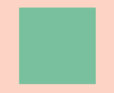
Soft Skills
Good Analytical skills
SQA Puzzle
A designer developed the color coding as shown on left for a health system that was to be installed in hospitals for patients use.
QA rejected the design. Why?
Detailed oriented and ability to put himself in shoes of multiple users
Notes:
Because emergency doors open from inside to outside. The guard was inside so the door could not have hit him.
Because the color coding is not recommended for color blind. It should have more contrast.

Slide 24
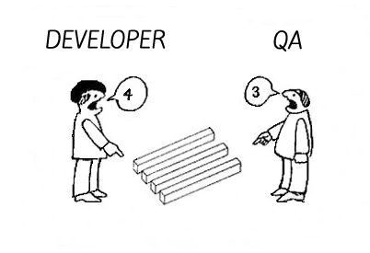
Soft Skills
Good Communication skills
Understanding yet persuasive
Notes:
Because emergency doors open from inside to outside. The guard was inside so the door could not have hit him.
Because the color coding is recommended for color blind. It should have more contrast.

Slide 25
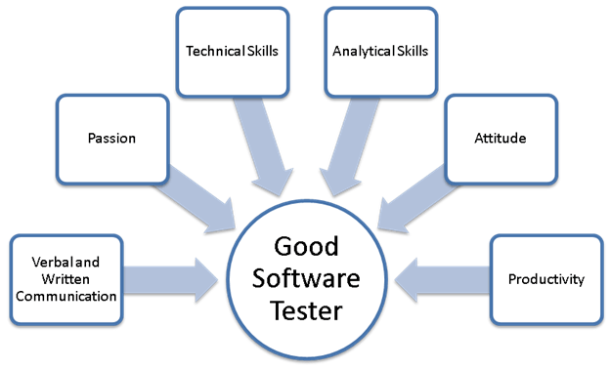
Soft Skills
A Good software tester

Slide 26
Exercise
Functional Testing
What do you understand of completeness, correctness and appropriateness of Software functional requirement
Can you identify any gap(s) in following requirements
You are building a solar system rental solution that will be rented to needy/elderly people living in rural areas of Pakistan. The solution is tech-driven and therefore the solution consists of a mobile app. That first release, monthly billing, payments and notifications can only be done through mobile app. They will get in-app notifications for pending payments based on their usage. They can report any issues/complains through app. They will also be able to make payment through the mobile app. The solution In-app supports credit card payments only. Different usage and analytical data is sent from devices to central servers through GSM (mobile SIM).

Slide 27
Exercise
Functional Testing
You feel that the performance of the website is slower on your mobile and you have reported the bug. But the performance seems fine when developers try to test on their machine. They are suggesting that the performance issue is because of your own mobile.
What would be your approach to follow up on this?

Slide 28
Applications and Systems

Slide 29
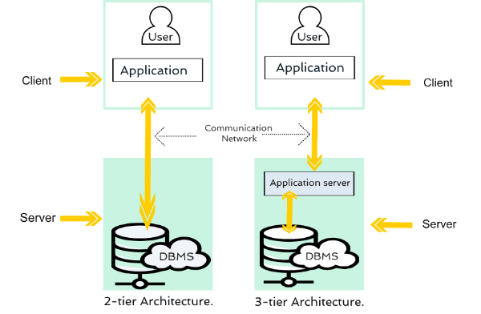
Web Applications
2-tire and 3-tier Architecture

Slide 30
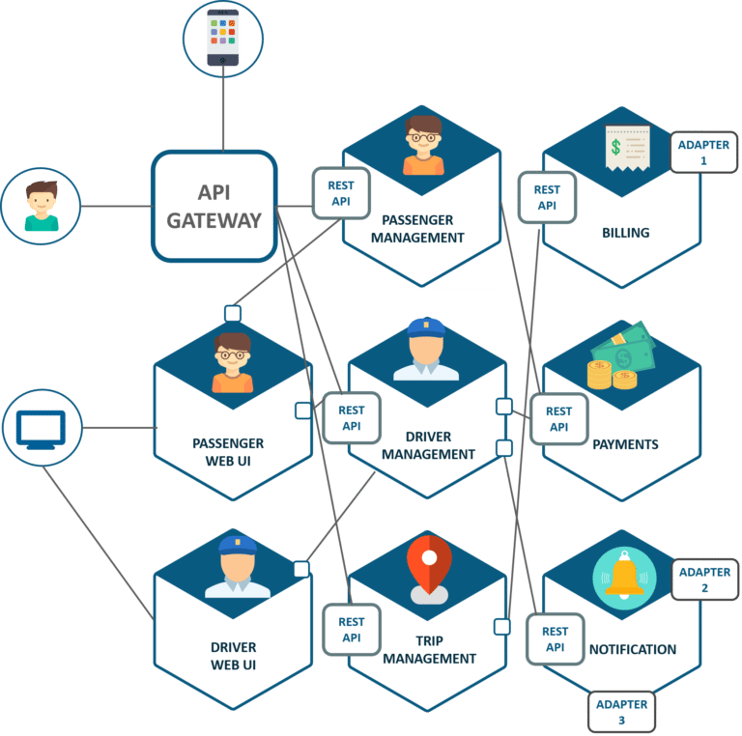
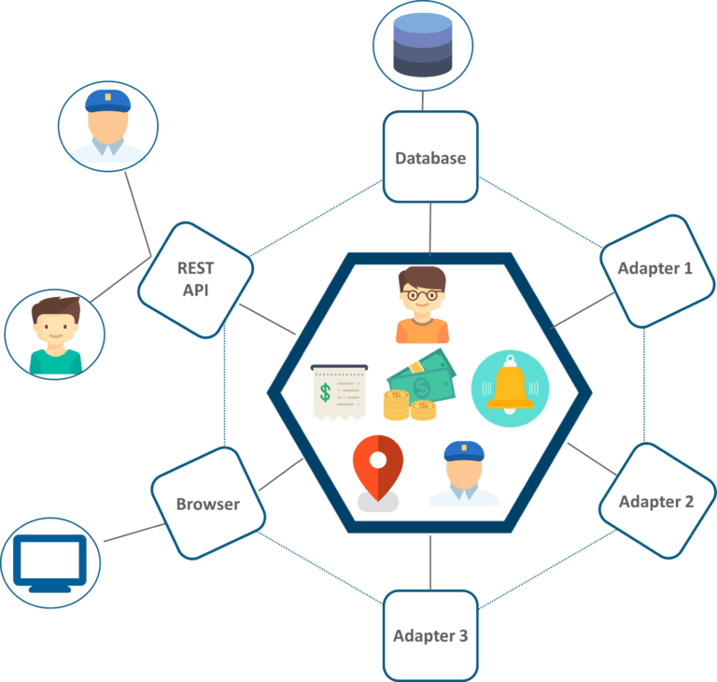
Web Applications
Monolithic vs Micro-service architecture

Slide 31
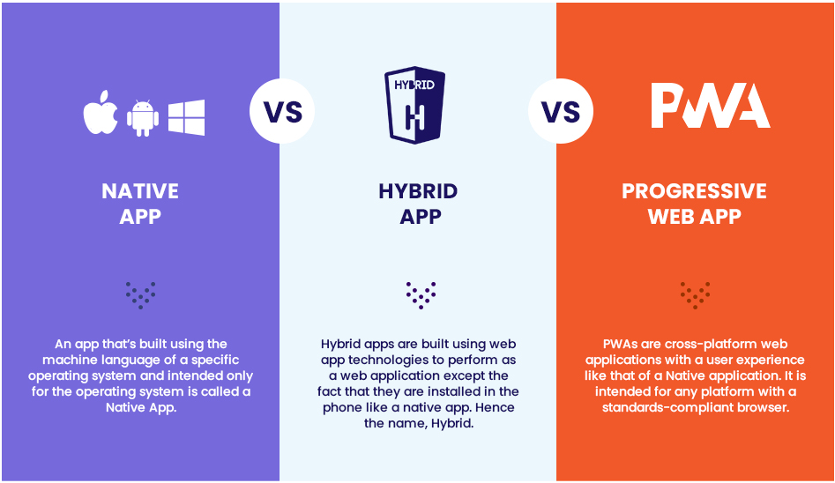
Mobile Applications

Slide 32
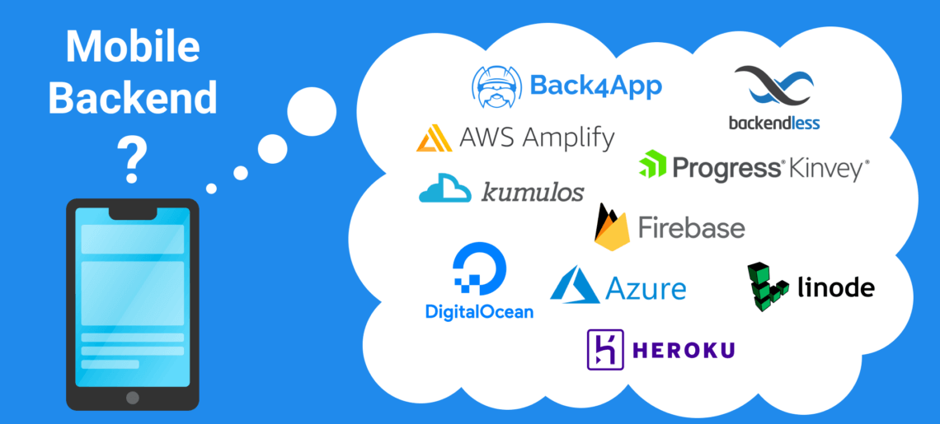
Mobile Applications
Mobile App with backend
App that dont need backend (calculator, compass, measurrr, etc.) vs App that need backend (Amazon, Creem, Netflix, etc.)

Slide 33
Getting Started with Functional Testing

Slide 34
Example of Functional Testing
Functional Testing
List Size | Input set of integers | Expected Output (minimum value)
5 | 6, 9, 2, 16, 19
7 | 96, 11, 32, 9, 39, 99, 91
7 | 31, 36, 42, 16, 65, 76, 81
6 | 106,109,88,111, 114,116
6 | 61,69,99,31,21,69
2
9
16
88
21
Are These Enough?

Slide 35
Other Possibilities
Functional Testing
An empty list
A list where minimum element is negative
A list of all negative elements
A list with duplicate elements
A list that contains non numeric characters
A list where one element is greater than the maximum or minimum value

Slide 36
Possible test scenarios for a login?
Functional Testing
Field validations
Empty fields + Ok button
One valid + one empty + Ok button
Not allowed characters (if any) + Ok button
Greater than maximum allowed characters
Incorrect email format
Invalid entries
Invalid username and/or password
Valid credential for deleted/locked user
Old credentials for an updated password

Slide 37
Possible test scenarios for a login?
Functional Testing
Valid Entries
Valid User and password + any button other than Ok
Valid user and pass + ok
Valid credential for recently created user
New credential for recently updated password
Logout and login again
Login with remember me marked
Login with remember me unmarked

Slide 38
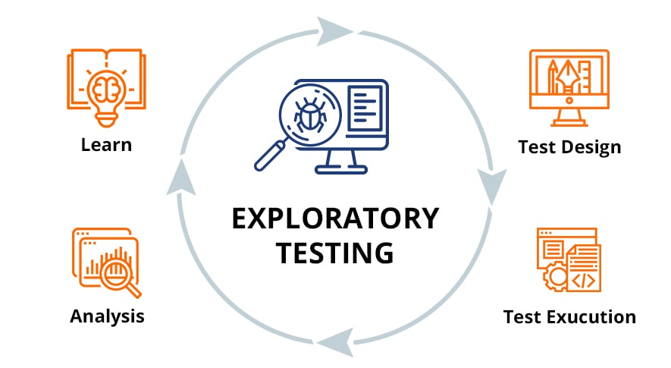
What to do when you are given an application for testing?
Exploratory Testing
Learn and test at the same time

Slide 39
Understand and Document Functionality
What is Software Testing
https://demo.vuestorefront.io/
https://www.demoblaze.com/index.html

Slide 40
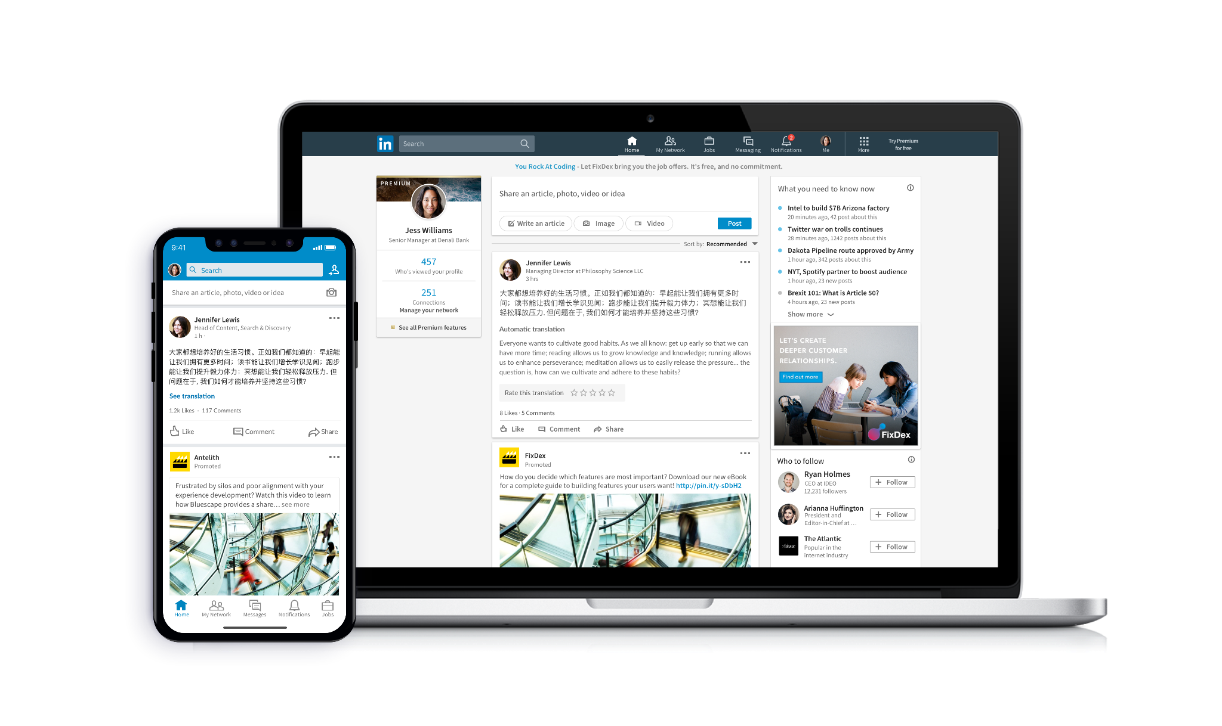
Exercise
Functional Testing
Identify what you will test for messaging feature of Whatsapp?
Identify what you will test for facebook/linkedin feed?

Slide 41
Exercise
Functional Testing
Identify functionalities of Whatsapp application?

Slide 42
Reading Break and Exercise

Slide 43
Reading
What is Software Testing
https://istqb-main-web-prod.s3.amazonaws.com/media/documents/ISTQB-CTFL_Syllabus_2018_v3.1.1.pdf
1.1, 1.2, 1.5
https://iso25000.com/index.php/en/iso-25000-standards/iso-25010
https://www.linkedin.com/pulse/continuous-testing-devops-dan-ashby/

Slide 44
Q&A
Instructor Notes

